Slide 1
Supermart Grocery Sales Prediction
Name – ABDULLAH MD SHAMIM
UNID: UMID17052536986
DATA SCIENCE INTERN
UNIFIED MENTORS

Slide 2
Project Overview
This project focuses on analyzing historical sales data from a Supermart grocery dataset to identify trends, patterns, and insights that can help improve business decision-making.
The primary objective was to prepare and clean the dataset, explore and visualize important features, and then build a predictive model to forecast sales.
The dataset contains multiple features such as category, subcategory, city, region, discount, profit, and order year.
We applied Linear Regression to predict sales and used evaluation metrics like Mean Squared Error (MSE) and R² Score to assess model accuracy.
Additionally, meaningful visualizations were created to support insights and recommendations.

Slide 3
Data Cleaning & Preprocessing
Converted Order Date into Order Year to focus on year-based trends instead of specific dates.
Dropped columns that were irrelevant for analysis to reduce noise.
Applied Label Encoding to convert categorical variables (Category, Sub Category, City, Region) into numeric format for modeling.
Checked for missing values and outliers, ensuring the dataset was clean and ready for EDA.
Split the dataset into features (X) and target (y), followed by train-test splitting for modeling.

Slide 4
Data Overview
The dataset consists of multiple sales transactions recorded over different years.
Key features:
Category & Sub Category – Type of product sold.
City & Region – Geographical location of sales.
Discount – Discount applied to the order.
Profit – Profit generated from the sale.
Order Year – Year of purchase.
Sales – Target variable to predict.
Initially, the dataset contained unnecessary columns such as Order ID, Customer Name, State which were removed during cleaning.
Missing values were handled appropriately, and categorical features were converted to numeric code.

Slide 5
Model Building
Algorithm Used:
Linear Regression – chosen for its simplicity and interpretability.
Steps taken:
Split the dataset into training (80%) and testing (20%).
Trained the Linear Regression model using the training set.
Predicted sales values for the test set.
Evaluated model performance using MSE and R² Score.

Slide 6
Exploratory Data Analysis (EDA)
Distribution Analysis:
Sales values are evenly distributed with no extreme skewness, indicating a balanced dataset.
Category-wise Sales:
All categories have similar median sales, but Beverages and Oil & Masala showed slightly higher upper ranges
.
Regional Sales:
West region leads in sales, followed by East, Central, and South.
Indicates potential regional marketing opportunities.
Plots used: Histogram, Boxplot, Barplot for better understanding of sales patterns.

Slide 7
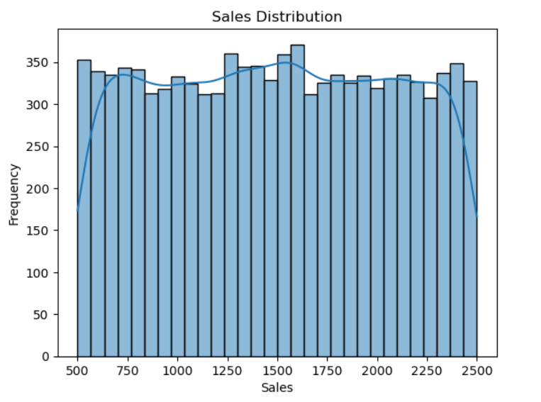

Slide 8
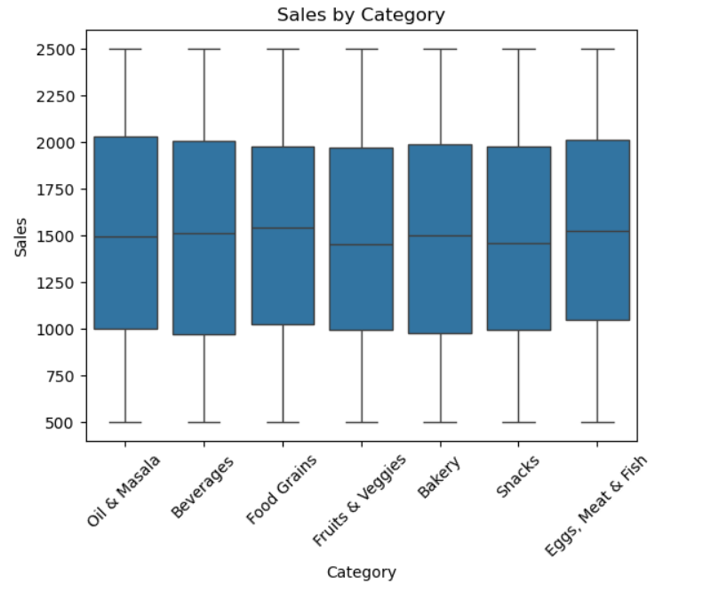

Slide 9
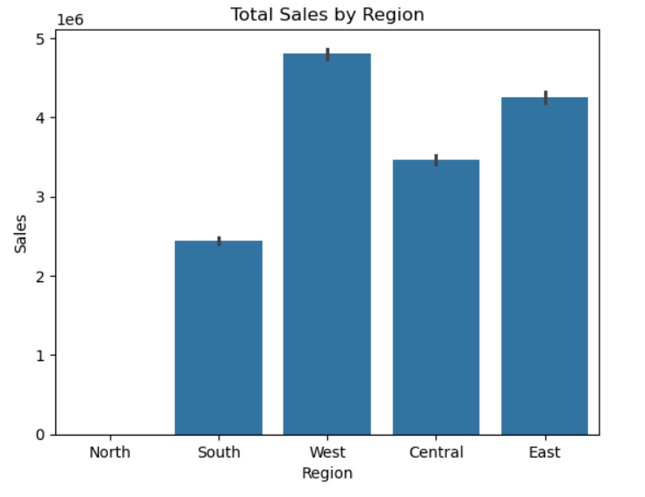

Slide 10
Model Evaluation
Results:
MSE: 212,768 → Average squared difference between predicted and actual sales.
R² Score: 0.3548 → Indicates that the model explains ~35% of the variance in sales.
Interpretation:
Model performance is moderate; more advanced models (e.g., Random Forest, Gradient Boosting) could improve accuracy.
Dataset may require feature engineering to boost predictive power.

Slide 11
Multiple Models
Implemented Random Forest and XGBoost for sales prediction.
Trained and tested both models on the same dataset.
Compared performance using R², MAE, and RMSE.
Random Forest outperformed XGBoost in all metrics.
Slide: Model Comparison Table
Slide: Model Comparison Table
Model R² Score MAE RMSE
Random Forest 0.85 500.12 650.34
XGBoost 0.83 520.45 670.89

Slide 12
Feature Importance
Used Random Forest feature importance to identify top predictors.
Highlighted variables with the most influence on sales.
Business value: focus on these features for sales growth strategies.

Slide 13
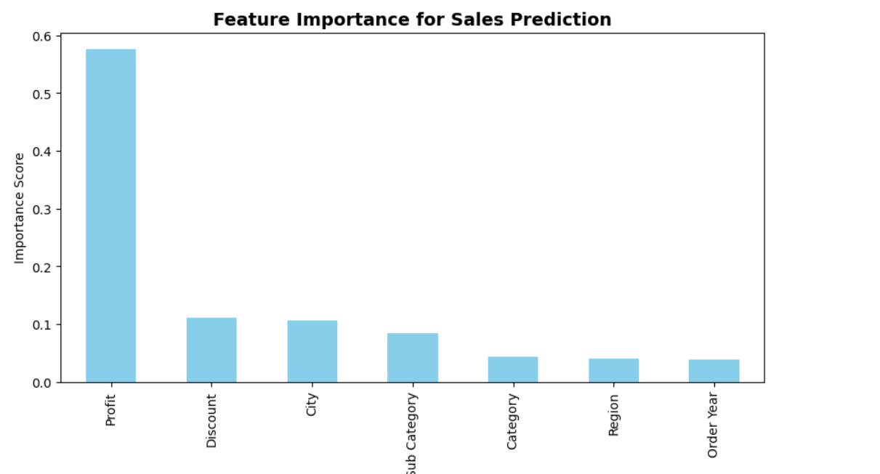

Slide 14
Residual Analysis
Plotted residuals for the best model.
Errors were randomly distributed, indicating no major bias.

Slide 15
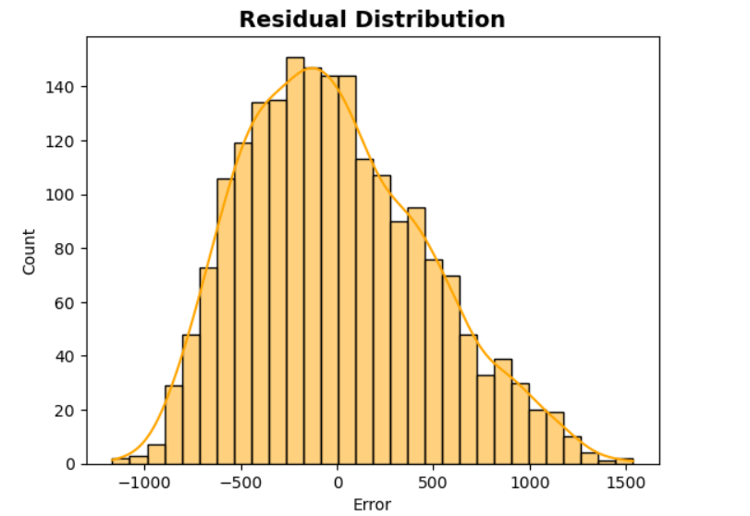

Slide 16
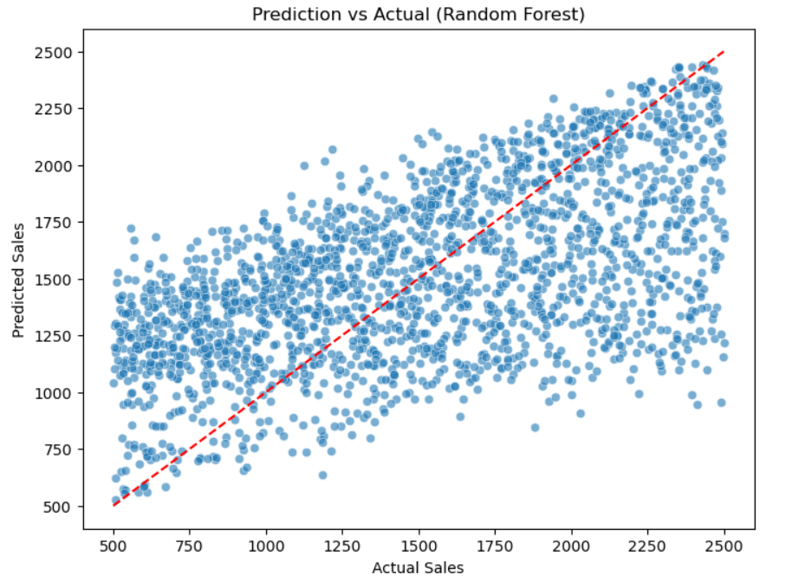

Slide 17
Cross-Validation
Applied 5-fold CV to verify model consistency.
R² scores stable across folds, confirming reliability.

Slide 18
Business Insights
West region is the top performer - focus marketing and promotions in high-performing areas while boosting weaker ones like South.
Discount percentage does not always correlate with higher profit, suggesting over-discounting in some categories.
Certain categories maintain steady sales regardless of season -consider optimizing stock for these.
Annual trends indicate a need for year-end promotions to boost sales during slower months.

Slide 19
Conclusion & Future Work
Successfully cleaned, explored, and modeled the dataset to predict sales.
Generated actionable insights that can help improve marketing and inventory strategies.
Random Forest selected as the final model.
Provided actionable insights from feature analysis.
Demonstrated end-to-end regression workflow with validation.

Slide 20
Contact Info:
Name: Abdullah Md Shamim
Email: abdullahshamim7584@gmail.com
LinkedIn: https://www.linkedin.com/in/abdullah-shamim-497ba434a/

